Slide 1
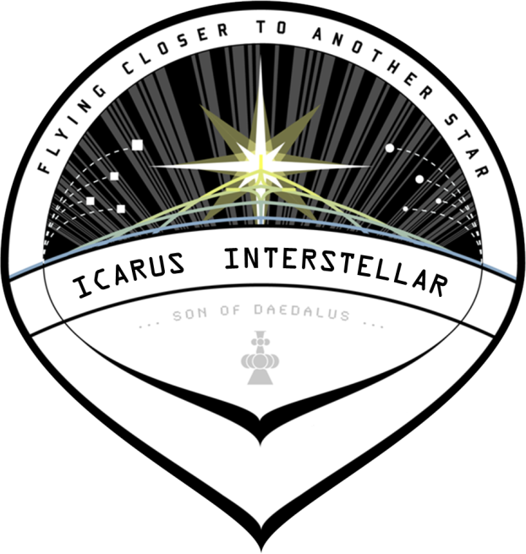

Icarus Interstellar
International Interstellar Spacecraft Design Team
Space Law:
A Framework for an Interstellar Constitution
Donna A. Dulo, JD, PhD(c)
Icarus Designer
Project Icarus: Son of Daedalus “Flying Closer to Another Star”

Slide 2
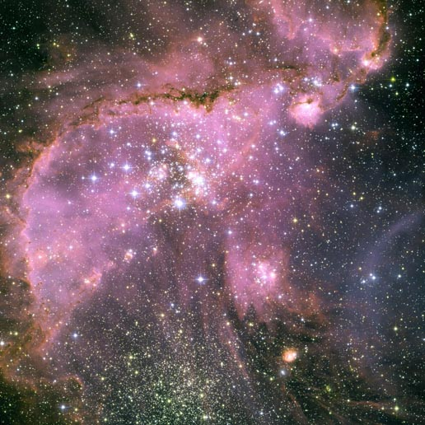
Introduction
Law is the foundation for all societies
Current international law has no framework for an interstellar mission
A long term mission would have unique requirements for law and order
A “bold and audacious” legal foundation must be established to accommodate the needs of such a unique human endeavor

Slide 3
Advances in Human Constitutions
Code of Ur-Nammu
Code of Hammurabi
Draconian Constitution
Code of Justinian
Magna Carta
US Constitution
South African Constitution
2050 BC
1772 BC
650 BC
529 AD
1215
1787
1997
Social Justice, Cultural Human Rights
Protection of Basic Civil Privileges
Individual Rights
Control of Population

Slide 4

An Interstellar Constitution
An interstellar constitution would take human jurisprudence onto another level
Rights and responsibility of people to each other
A balancing of those rights and responsibilities
Protection of the space environment
Interaction with alien beings/organisms
Scientific rights and responsibilities

Slide 5
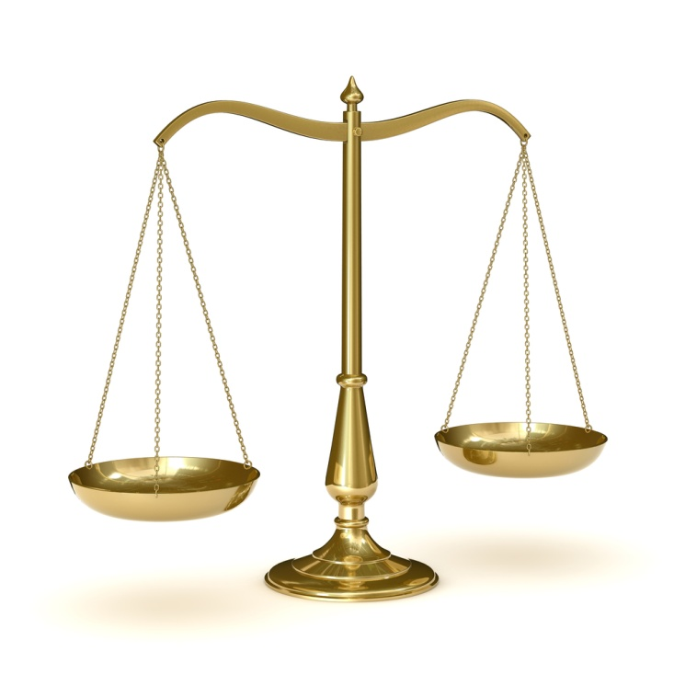
Importance of a Current Discussion
Law typically lags technology by many years or decades
Railway laws lagged by decades resulting in the loss of thousands of lives
Air Law:
  Wright Brothers First Flight: 1903
  First Air Law Treatise: 1910
    Dutch Scholar Johanna Lycklama á Nijeholt
  Air Commerce Act 1926
  Civil Aeronautics Act & Authority 1938
  FAA Created 1958
FAA establishment was driven in part in response to catastrophic air accidents

Slide 6
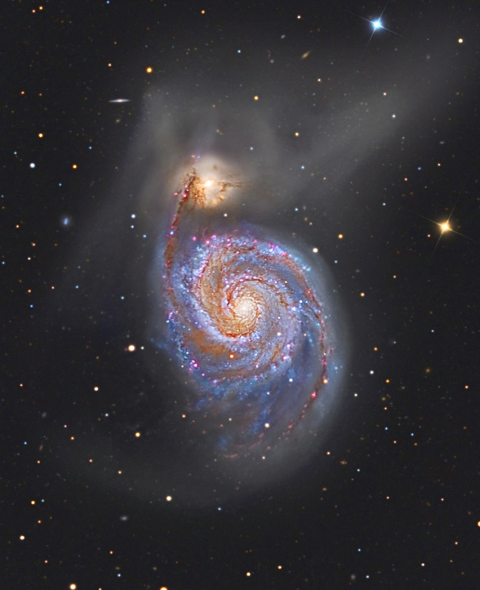
Importance of a Current Discussion
Involvement by all member nations and organizations involved in the starship program
International starship legal scholarship should not be not anchored to current international law
Legal innovation and open mindedness
Evolution of bold legal concepts and scholarship over time

Slide 7
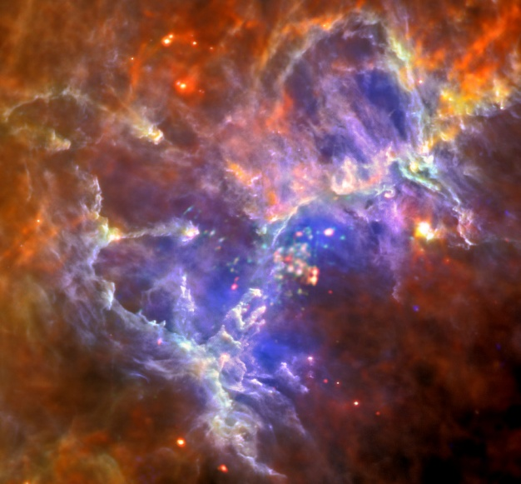
Purpose of the Framework
To begin the discussion of interstellar jurisprudence
To set an initial framework to encourage scholarly debate
To enhance awareness in the legal and scientific communities of the need for early discussions
Act as a starting point for further development of current space law
To provide a malleable, evolvable interstellar constitutional structure

Slide 8
Framework Foundations: Governance
Balance legislature and judiciary
Balance starship command with society command
Critical Issues
  Prevention of mutiny
  Prevention of tyranny
  Leadership impasse
  Enforcement of laws
  Evolution of laws
  Leadership election/replacement
  Maintenance of civil rights
Judicial Panel
Starship Command
Society Leadership
Legislative Body
Governance

Slide 9
Framework Foundations: Rights
Balance rights and responsibilities
Individuals have responsibility to each other and society
Society has responsibility to individuals and itself
Critical Issues
  Rights conflicts
  Responsibility conflicts
  Ultimate rights: society v individual?
  Conflict of rights and mission
  Fairness v mission continuity
  Maintenance of civil rights
Societal Rights
Individual
Rights
Individual Responsibility
Societal Responsibilities
Rights & Responsibilities

Slide 10
Framework Foundations: Space Stewardship
Preservation of the space environment: space stewardship
Interaction with alien life
  Micro-organisms
  Vegetation
  Intelligent life
Development of prime directives
  First contact
  Second contact
  Continual contact
  Integration
Alien Life Preservation
Space Environment
Preservation
Mission Requirements & Safety
Human Life & Safety
Space Stewardship

Slide 11
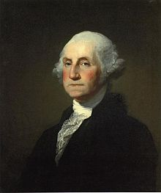
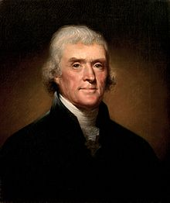


Framework Foundations: Alien Rights
Inalienable rights?
What about my alien rights?
Alien life and interactions should be a major point of serious discussion in starship jurisprudence.

Slide 12
Framework Foundations: Property Rights
Scientific discovery will be prevalent on a starship mission
Space resources and physical property acquisition will be an issue
A further application of individual v societal rights
Personal v real property an issue
  Colonization property
  Property stakes outside the colony
  Personal property limits?
Individual Intellectual Property Rights
Individual
Property Rights
Starship Collective Property Rights
Starship Collective Intellectual Property Rights
Property Rights

Slide 13
Framework Modular Structure
Each diamond is a discrete area of balanced jurisprudence
Clusters of constitutional area diamonds can be added or taken away from framework
Modularity helps maintain a structured evolution of the framework
Modularity eliminates legal complexity and fosters focused discussion of specific legal areas

Slide 14
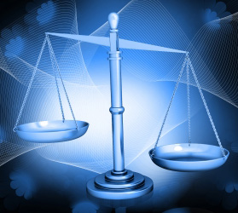
Conclusion
The framework provides balance in all legal areas
  Rights and responsibilities
  Individuals and starship society
  Starship and space stewardship
  Starship command and starship society leadership
This presentation gives a sample of legal area diamonds, the actual framework is much more extensive
The framework is a starting point. Hopefully the discussion will continue throughout the starship program to provide a sound constitution for mission commencement.

Slide 15




Thank You
Acknowledgements:
  Images courtesy of NASA & Icarus Interstellar
Questions?

